Slide 1
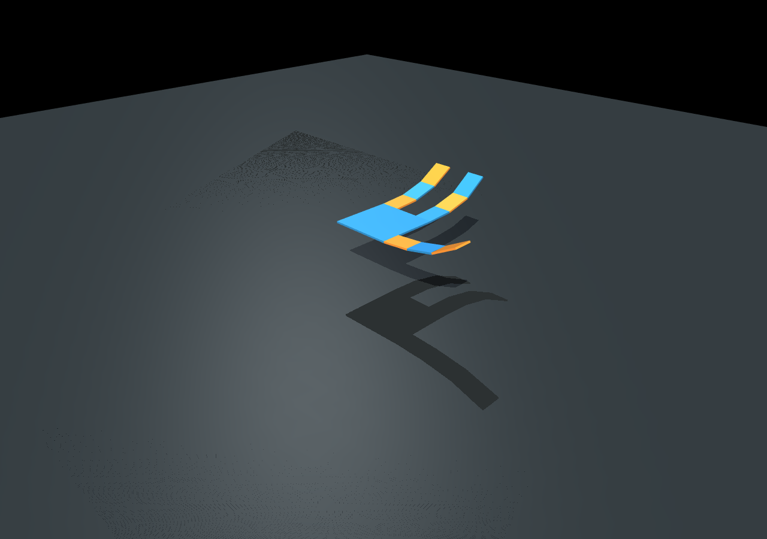
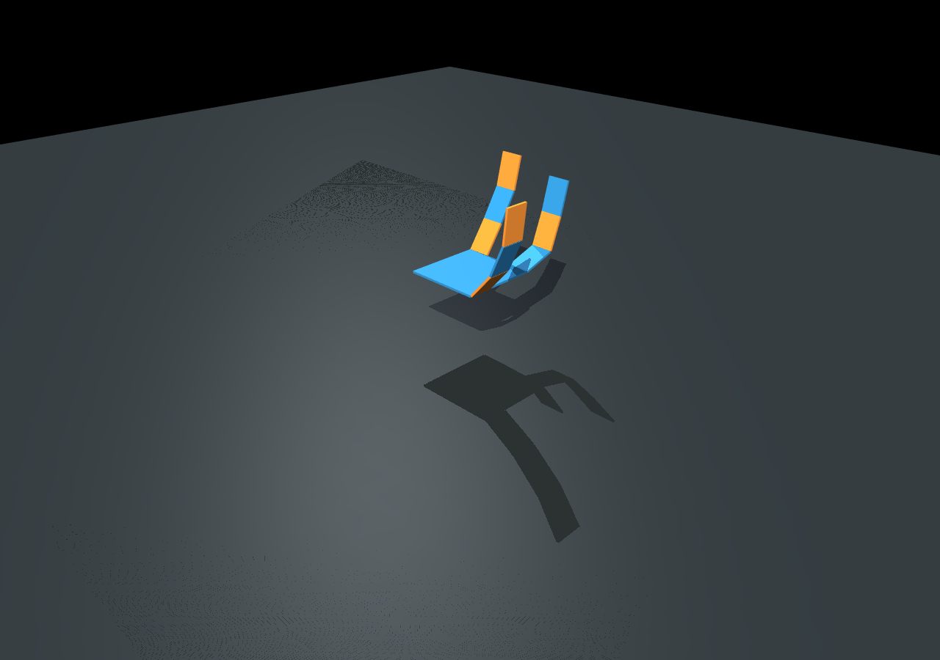
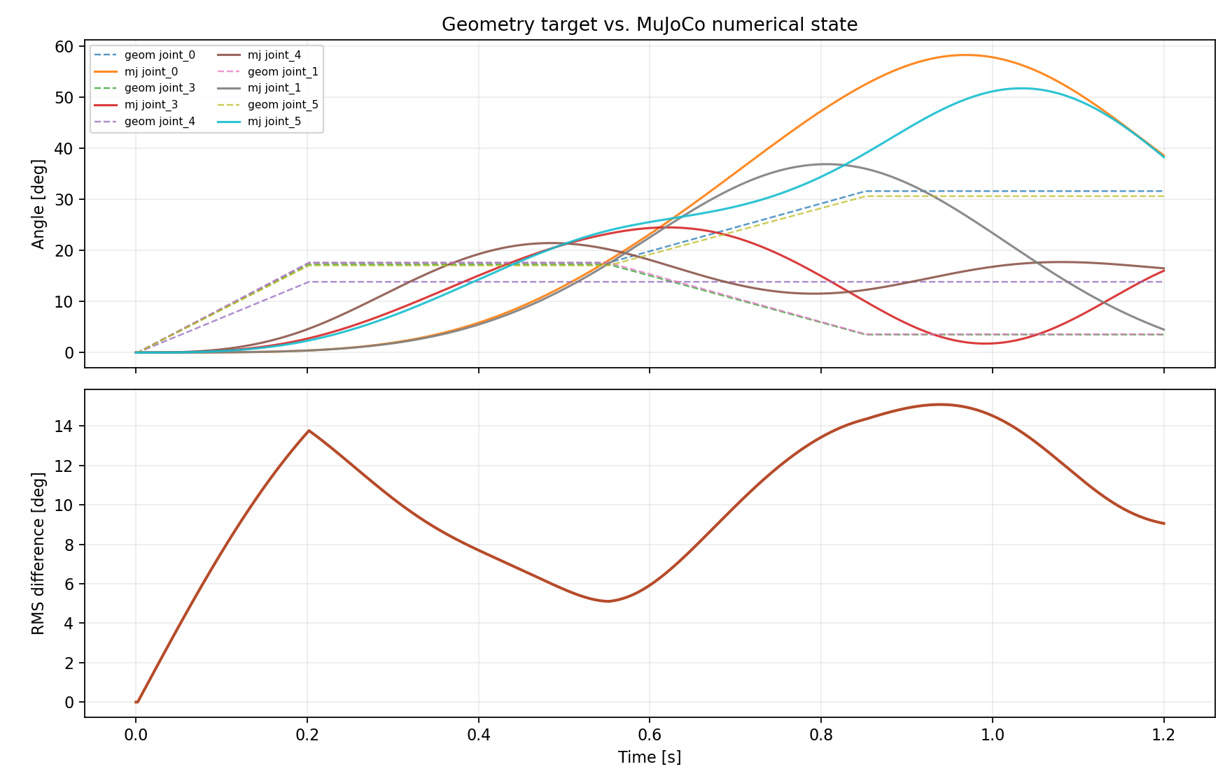
MuJoCo Numerical Simulation Framework for SDAS Hands
Yushuo Wang | Synergy Hand Simulation | Physical Simulation Final Poster
Problem Statement
Methodology
Goal: replace geometry playback with MuJoCo numerical integration.
Three-layer interface: distribution -> driver command -> MuJoCo execution.
Inputs: .ohd simulation definition, hand model path, time step, duration, driver time series, and distribution type.
Outputs: joint trajectories, target-vs-state error, contact count log, generated MJCF audit file, and rendered MuJoCo screenshots.
Constraint: the upgraded physics path must not include damper elements, viscous joint terms, tendon velocity friction, or hand-written -D qdot forces.
SoftHand 2 Eq. 43
SDAS Schur map
.ohd time series
MuJoCo mj_step
Dynamics structure
B_sigma
sigma(t)
q(t), logs
Numerical control law
1. Interpolate each driver sample at time t.
2. Position inputs set sigma; velocity inputs integrate into sigma; force inputs map directly to joint generalized forces.
3. Compute q_ref = B_sigma sigma.
4. Apply tau = Kp(q_ref - q) + force_scale B_sigma f_sigma.
5. Advance only with MuJoCo mj_step; save q, q_ref, qdot, tau, and ncon.
Why geometry was insufficient
The previous viewer directly assigned qpos from the synergy solver. It showed the intended pose, but skipped inertia, joint limits, MuJoCo constraints, and time evolution.
The new path treats the geometry solution as q_ref and lets MuJoCo integrate the actual q(t).
Implemented user entry point
python scripts/run_mujoco_sdas.py "models/ohd test/mujoco_sdas_step.ohd"
Success criteria implemented
1. .ohd file drives MuJoCo with time-varying driver inputs.
2. SDAS maps low-dimensional drivers into joint-space references.
3. No damping/damper/velocity actuator terms appear in generated MJCF.
4. At least two rendered postures and a geometry-vs-numerical comparison are generated automatically.
Experimental Results
Demo: three-finger gripper B, SDAS distribution, two time-varying drivers.
Literature Review
SoftHand 2 provides the numerical-model motivation, while SDAS provides this project's no-damper transmission abstraction.
t = 0.35 s: common-mode closure
t = 1.05 s: differential SDAS posture
Key equations retained
Postural synergy: q = S sigma
Adaptive transmission: R q = x, tau = R^T tau_M
Free-motion mapping: S_R = E^-1 R^T (R E^-1 R^T)^-1
MuJoCo target: q_ref(t) = B_sigma sigma(t)
Geometry target q_ref (dashed) versus MuJoCo state q(t), plus RMS difference.
Terms intentionally excluded
No joint viscous friction F qdot.
No tendon viscous friction or sliding-speed friction state.
No damper transmissions or dynamic-synergy damper model.
No PD/PI velocity feedback; position tracking uses only Kp(q_ref - q).
Quantitative check
600 MuJoCo steps at dt = 0.002 s; 9 hinge joints; 2 SDAS drivers.
RMS target-state difference = 0.1848 rad; max absolute difference = 0.5661 rad.
Generated MJCF audit: no damping, damper, or velocity actuator terms.
Conclusion
SDAS interpretation
Dual-ended tendon routing gives two path-dependent transmission vectors R_A and R_B. Their Schur-complement solution yields common-mode closure and differential reconfiguration without adding damper hardware.
Outcome
The project now supports an .ohd-driven MuJoCo numerical simulation path that preserves SDAS synergy mapping while removing damper-related computations.
The interface separates model, driver sequence, distribution type, numerical settings, and output assets, making repeated experiments reproducible.
Next engineering step: extend endpoint distributions to task-space objectives and add optional contact-force postprocessing when grasp objects are introduced.
Sources: Della Santina et al., IEEE TRO 2018; project SDAS derivation; synergy_hand_sim MuJoCo SDAS demo run on 2026-06-03.

